Slide 2
34760-Safety and Reliability in Robotic and Automation Systems
DTU Department of Electrical and Photonics Engineering

Slide 3
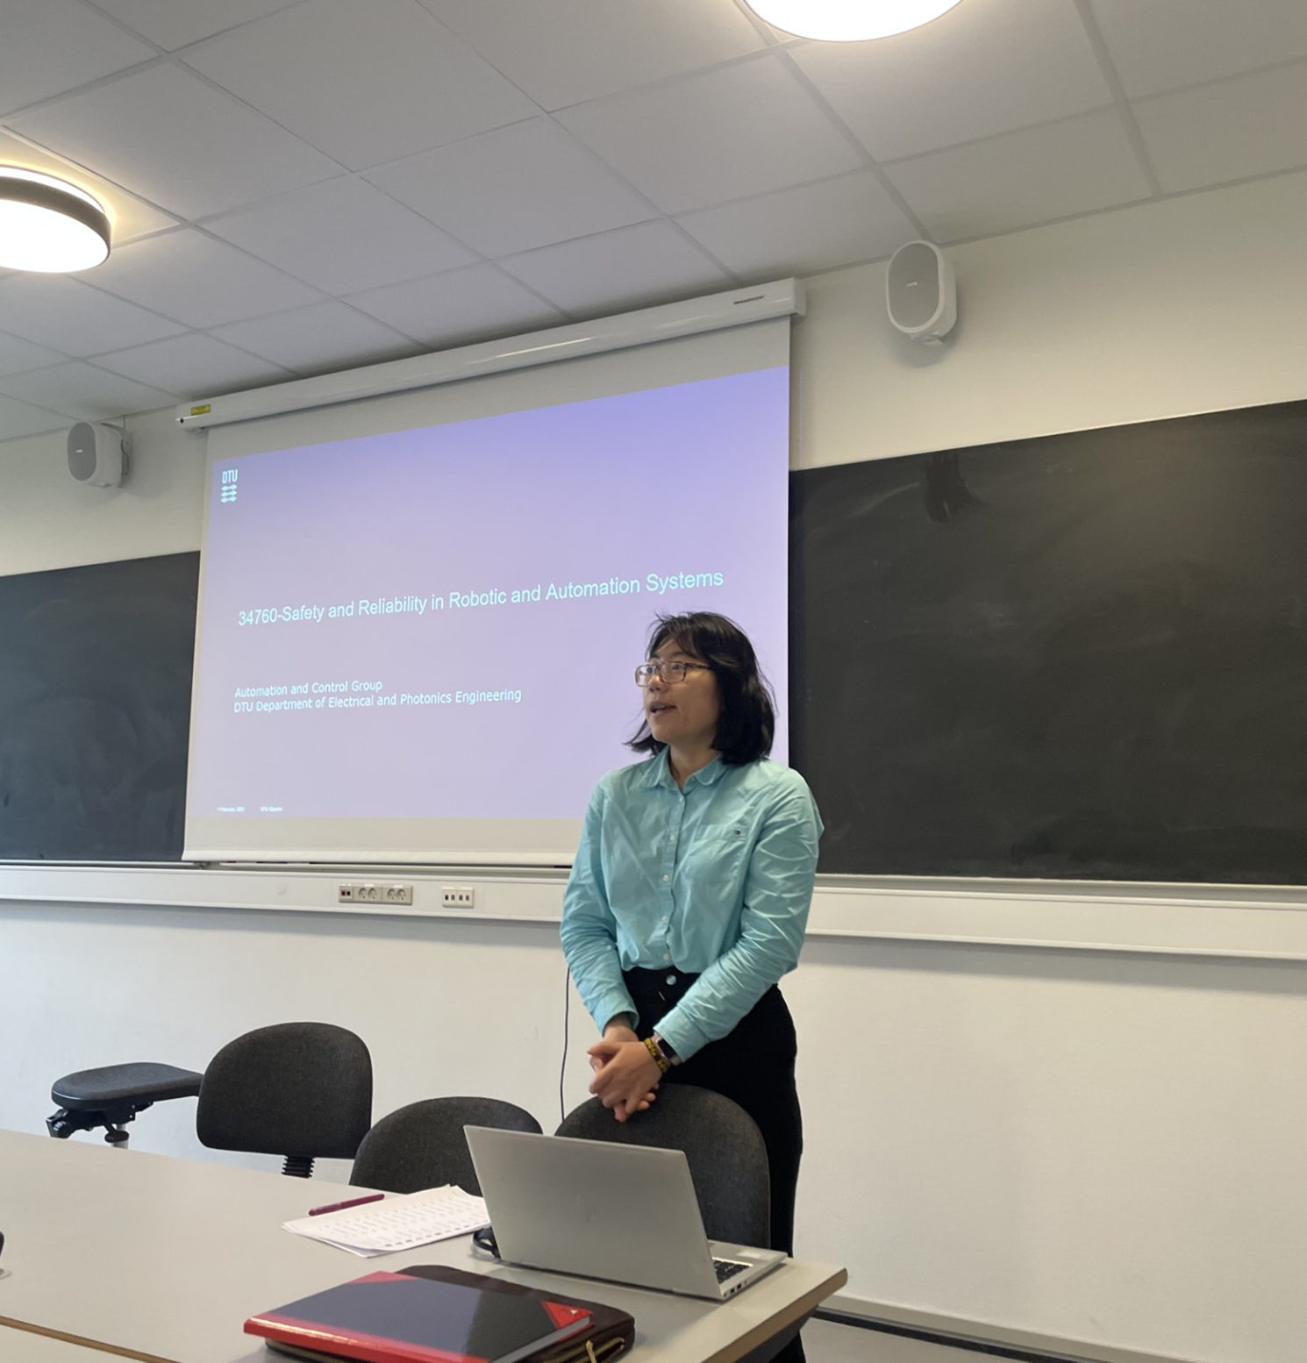
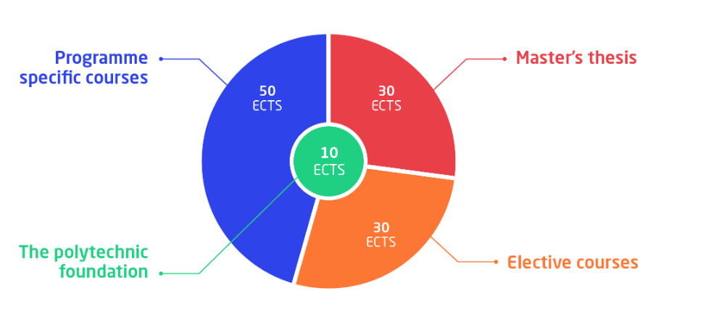
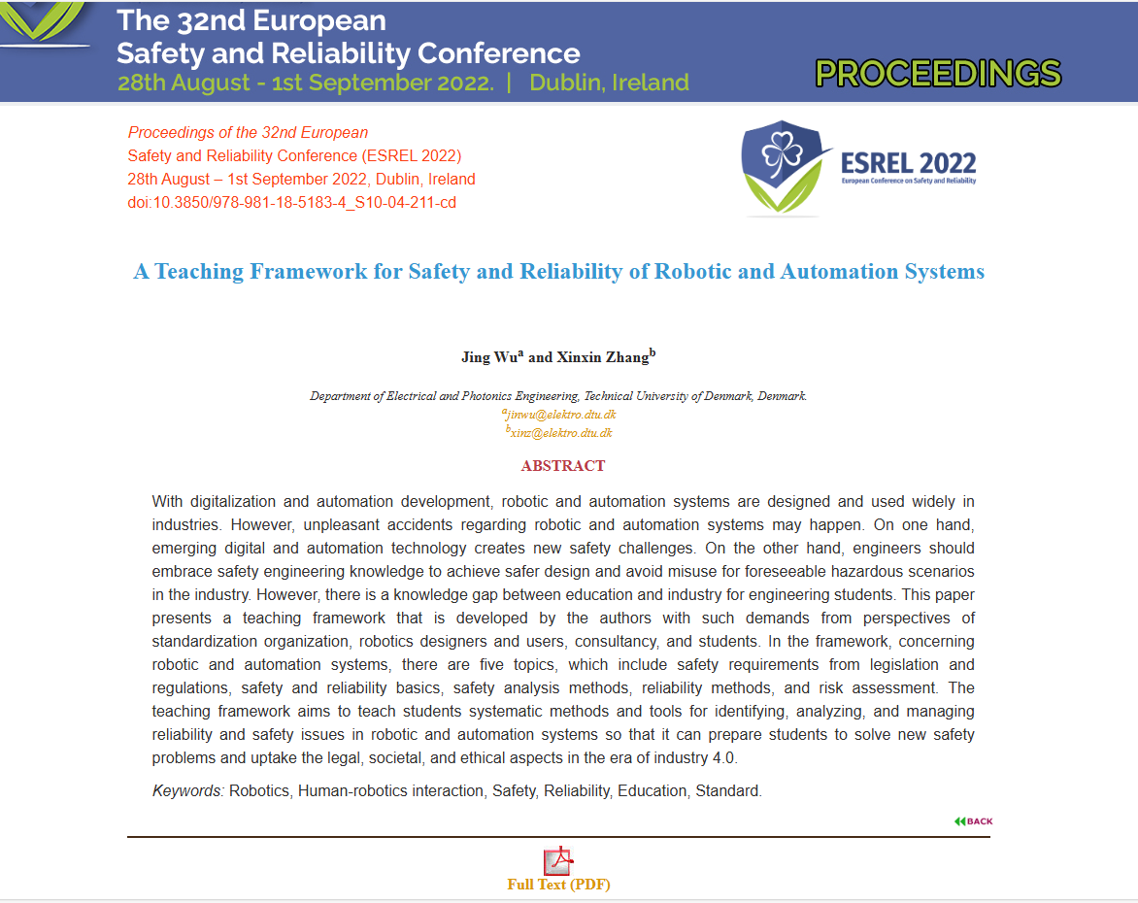
Notes:
The course 34760-Safety and Reliability in Robotic and Automation Systems, which I am mainly responsible for, initially a special offering with 17 students in 2022, based on good feedback, has evolved into a formal course with consistent growth, reaching 60 students in 2023 and 74 registered students in 2024, which shows that increasingly welcomed by students.

Slide 4


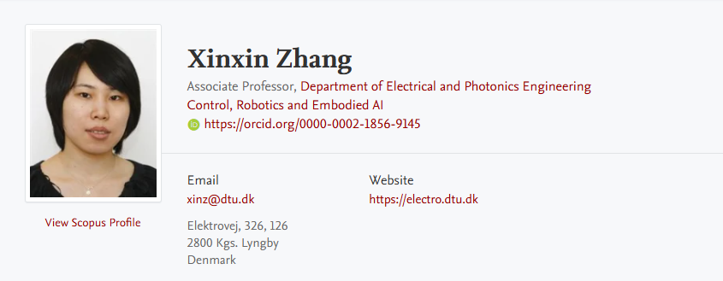
Lecturer and Teaching Assistant (TA)
Linna Li
TA
linnli@dtu.dk
Notes:
1.Rules about the class clarifications.
2. The course designs.

Slide 5
Students
Industry
Academy
Course introduction

Slide 6
Agenda
Course Objective, learning points and teaching materials
Course plan, structure and requirements

Slide 7
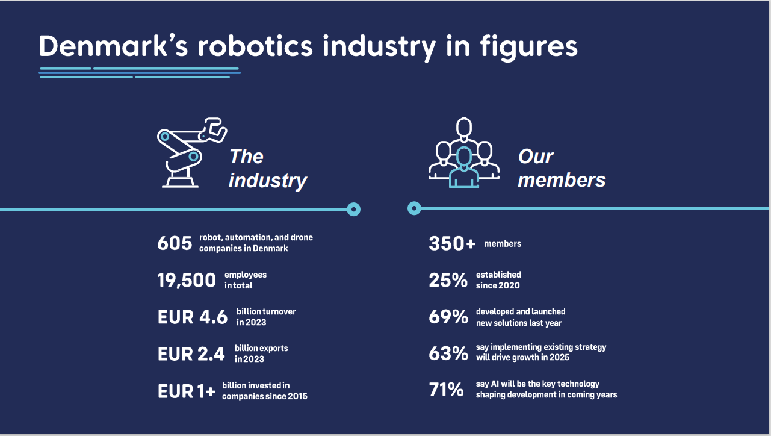
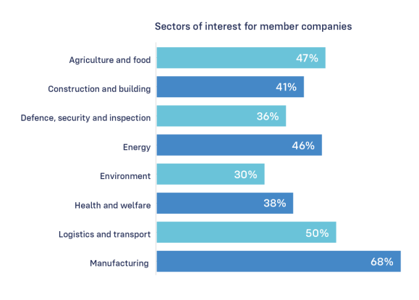
Background
From Odense-Robotics-Insight-Report-2025-Digital-version-single-pages

Slide 8
Top 5 Global Robotics Trends 2026
The International Federation of Robotics (IFR) has identified the key global trends that will influence how robotics technologies evolve and are applied across industries in the coming years.
AI-driven and autonomous robots: Robots are gaining new levels of independence through analytical, generative, and agentic AI, enabling them to learn new tasks, anticipate failures, and interact with humans in more intuitive ways.
IT meets OT: The convergence of information technology and operational technology is unlocking real-time insight, flexibility, and scalability across digital and physical production environments.
Humanoid robots move closer to real-world use: Humanoids are transitioning from lab-based prototypes into industrial settings, where reliability, safety, and efficiency are now critical.
Safety and cybersecurity take center stage: As robots become more connected and autonomous, safety, cybersecurity, and clear governance frameworks are essential to build trust in intelligent systems.
Robots as allies in addressing labor shortages: Robots are increasingly deployed to support the workforce, reducing strain, filling labor gaps, and helping make industrial jobs more attractive.
Notes:
https://www.youtube.com/watch?v=1-9PnPVGTGo
https://www.youtube.com/watch?v=rBNzAGlSfnI

Slide 9

Legal, societal and ethical?
The Bleeding Edge
Example:
Medical devices: Over the past ten years, nearly 70 million Americans have been implanted with medical devices
Notes:
https://www.youtube.com/watch?v=mZBeIoa0kHM

Slide 10
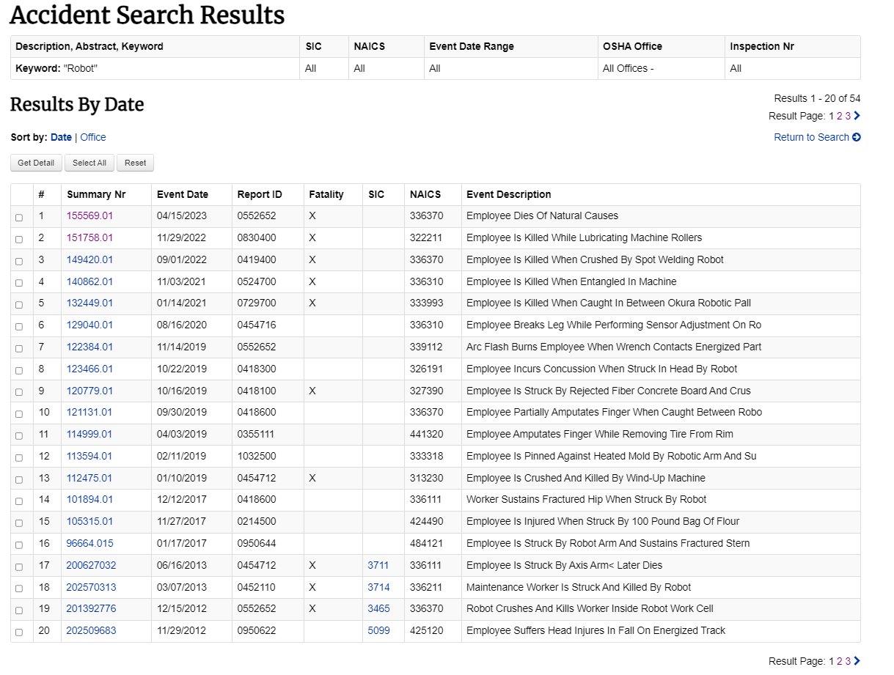
Previous Accidents
The Occupational Safety and Health Administration is a large regulatory agency of the United States Department of Labor
Notes:
Graphic: Slide shows a list of incidents from 2002– 2021 involving robots.
https://www.osha.gov/pls/imis/AccidentSearch.search?p_logger=1&acc_description=&acc_Abstract=&acc_keyword=robot&sic=&naics=&Office=All&officetype=All&endmonth=01&endday=31&endyear=2002&startmonth=12&startday=31&startyear=2021&InspNr=

Slide 11
Challenges
Digitalization and automation bring new challenges to safety and reliability
Technical artefacts in socio-cyber-physical systems from Lind (2023)
Levels of automation (Sheridan, 1992)
Lind, M. (2023). Foundations for Functional Modeling of Technical Artefacts. Foundations for Functional Modeling of Technical Artefacts. Springer. https://doi.org/10.1007/978-3-031-45918-4
Notes:
The purpose of automation (C and HMI) is to substitute human work by machines. Sheridan proposed a distinction between different levels of human interaction with automation. It illustrates how the role of the human operator changes when the level of automation is increased. In manual control, the operator interacts directly with the process through display and control devices and is responsible for the control and overall operation of the process. At the other extreme, fully automatic control, the operators role is reduced to be a monitor of the automated process. Supervisory control has two modes: 1. the computer monitors the human operator who is in control. 2. the computer is in control and is monitored by the human operator.

Slide 12
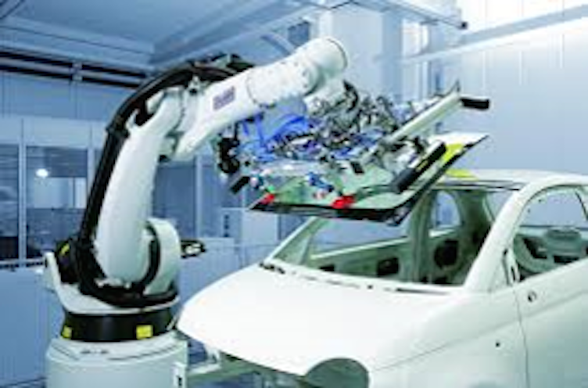
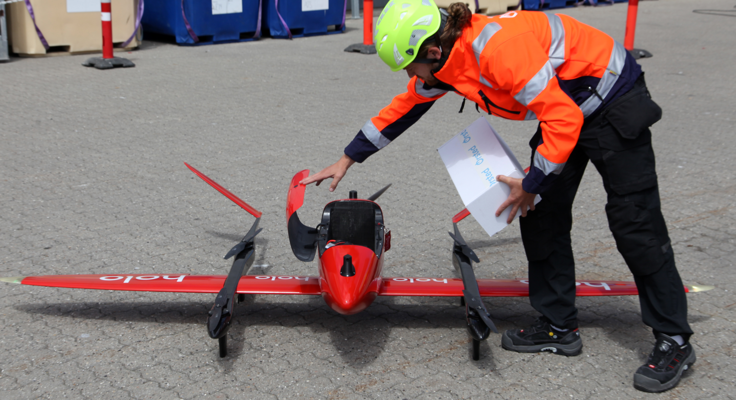
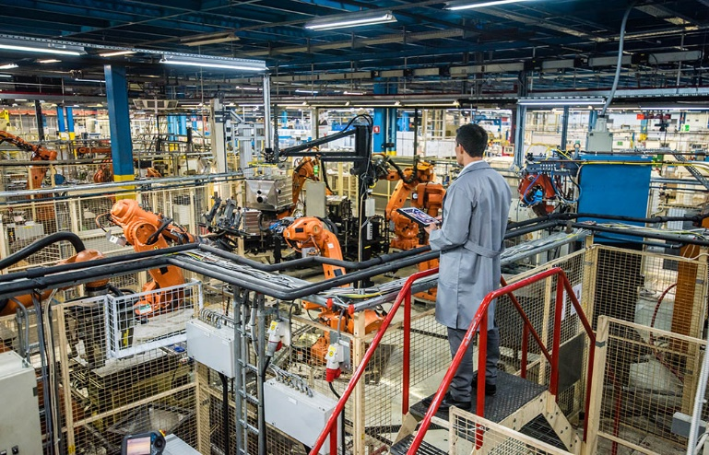
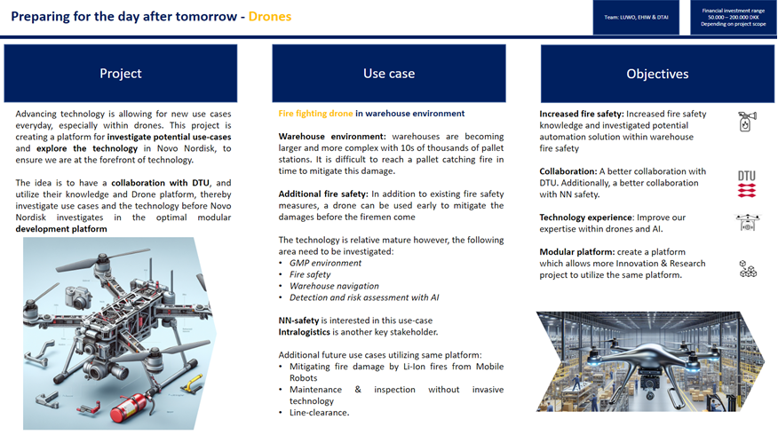
Challenges
Digitalization and automation bring new challenges to safety and reliability
Human
Operator
System
Human
monitor
Robotics
System
Notes:
Photo: Picture shows example of industrial robot doing task (placing windshield into automobile).
This is an example of a task that might be done by industrial robots to remove humans from potentially hazardous environments.

Slide 13
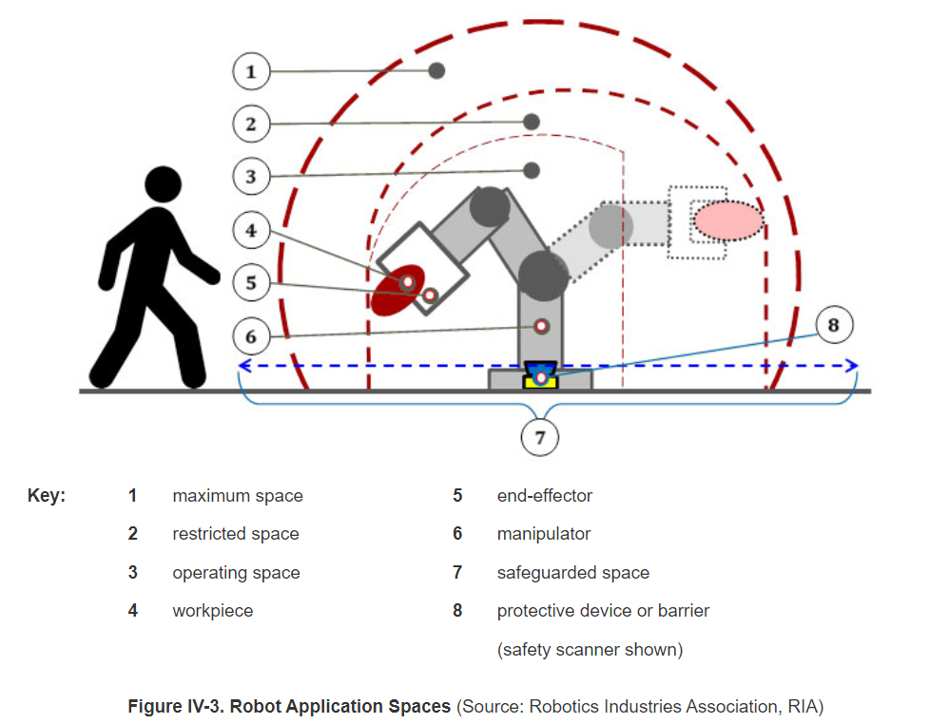
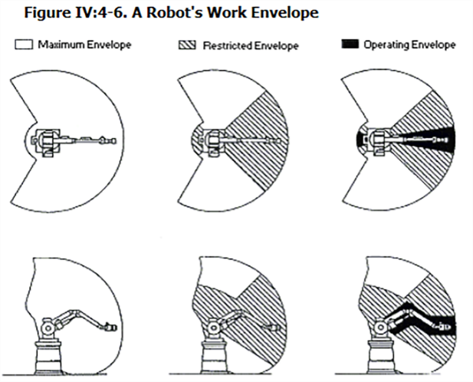
Challenges
Digitalization and automation bring new challenges for safety and reliability
Notes:
https://www.osha.gov/otm/section-4-safety-hazards/chapter-4
Overhead and side view of robot envelopes.
Maximum space-The volume of space encompassing the maximum designed movements of all robot parts including the end-effector, work piece, and attachments.
Restricted space-That portion of the maximum envelope (space) to which a robot is restricted by limiting devices.
Operating space-The portion of the restricted envelope that is actually used by the robot while performing its programmed motions.

Slide 14


Objectives
The aim of the course is to teach students systematic methods and tools for identifying, analyzing and managing reliability and safety issues in automation and robotic systems. These are useful to prepare students to solve new safety problems and uptake of the legal, societal and ethical aspects in the era of industry 4.0.
machinedesign.com

Slide 15

Learning objectives
www.facilitatedtraining.com
Define safety and reliability in relation with robotic and automation systems.
Describe fundamental safety concepts and theories in relation with robotic and automation systems.
Describe ethical aspects from the human-machine (robotics) perspective.
Explain what is standard, and what is CE marking.
Identify what are the relevant standards and required procedures.
Identify causing factors that contribute to the accidents in relation with robotic and automation systems by using accident-causing theories.
Perform system safety analysis using safety analysis methods by following the safety analysis procedure for robotic and automation systems.
Perform reliability analysis of robotic and automation systems for simple events using reliability analysis methods.
Perform digital twin simulation for risk assessment by using CoppeliaSim.
Perform risk assessment according to ISO12100.
Write sections of a risk assessment report.

Slide 16
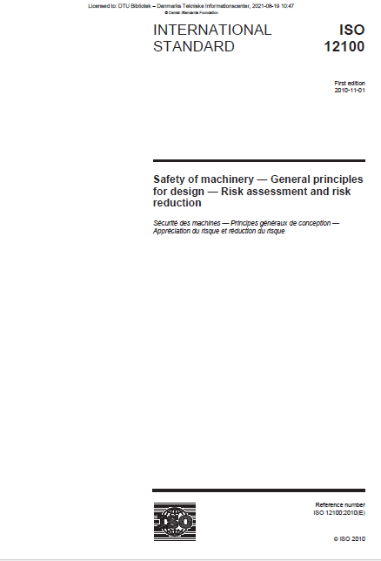
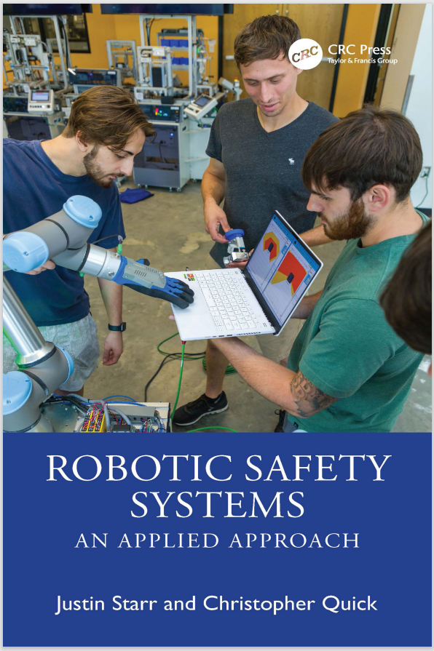
Teaching materials
Robot System Reliability and Safety: A Modern Approach By B.S. Dhillon
Justin, S., & Christopher, Q. (2024). Robotic Safety Systems: An Applied Approach. In Robotic Safety Systems: an Applied Approach (pp. 1–276). CRC Press.
Legislations and regulations https://standardsandmachinery.ds.dk/#/
Other tools such as https://www.safearoundrobots.com/toolkit/home and other literatures
Videos

Slide 17
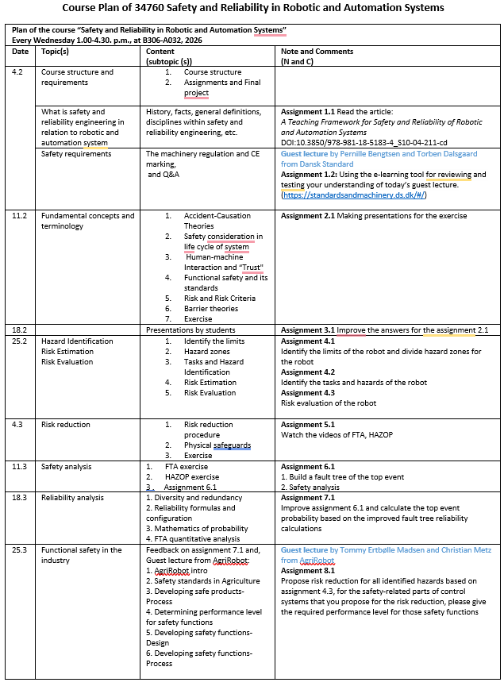

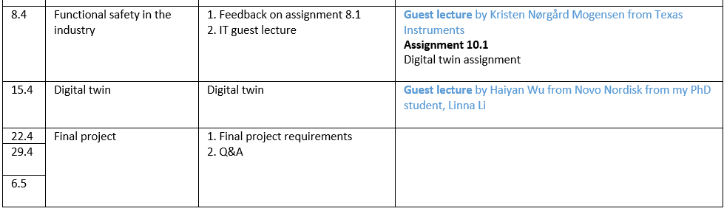
Course plan
Easter holiday
Slideshare.com

Slide 18
Course Structure
Topic 1
Legislations and Regulations
Standards, CE marking, functional safety…
Safety requirements
START
Topic 2
Safety and Reliability Basics
Theories including human-machine interactions and barrier theories
Safety consideration in life cycle of systems
Measure of risk and risk evaluation and acceptance
Determination of the limits of the machinery
Topic 3
Theories
Hazard identification
Safety Analysis Methods with Case Studies
Research perspective
Industrial practice perspective
Methods
Theory and mathematics
Topic 4
Reliability Analysis Methods with Case Studies
FTA
Topic 5
Risk estimation Risk = Probability X Consequence
Methods
Risk Assessment and AI
ISO 12100
Risk evaluation
Has the risk been adequately reduced?
END
YES
No
Risk reduction (use ISO12100)
Safeguards
Notes:
Wu, J., & Zhang, X. (2022). A Teaching Framework for Safety and Reliability of Robotic and Automation Systems. In M. C. Leva, L. Podofillini, & S. Wilson (Eds.), Proceedings of the 32nd European Safety and Reliability Conference (pp. 2293-2300). Research Publishing Services. https://doi.org/10.3850/978-981-18-5183-4_S10-04-211-cd

Slide 19



Topic 1. Safety requirements from legislation and regulations
Guest lecture: Standards, the machinery regulation and CE marking
Exercises
Reading materials:
https://standardsandmachinery.ds.dk/#/
The machinery regulation
Pernille Arendsdorf Bengtsen
Konsulent | Consultant
Afdeling for international politik og kursus
Dansk Standard

Slide 20
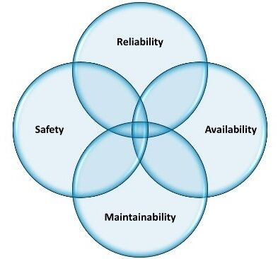
Topic 2. Safety and Reliability Basics
What is safety and reliability engineering in relation with robotics and automation system
Fundamental concepts and terminologies:
-Human-machine Interaction and “Trust"
- Barrier theories
Safety basics Safety consideration in life cycle of systems
Hazards Identification
Risk and risk assessment: measure of risk and risk evaluation and acceptance
Diversity and redundancy
Reliability basics Reliability formulas and configuration
Mathematics of probability

Slide 21
Topic 3. Safety analysis method (from Research perspective)
Safety analysis method | Targeting solving-problems | Tasks
HAZOP | 1.Identifying risks associated with the operation and maintenance of the system; 2. Identifying potential operability problems with the system | 1. Nodes decomposition (with respect to the system complexity and the potential magnitude and significance of the consequence） 2. Identification of deviations from the design intent using guide words 3. Identification of causes and consequences of deviations 4. Identification of safeguards 5. Proposing recommendations and required actions
FTA | Pinpointing the causes or combinations of causes that can lead to the defined top event for system safety and reliability | 1. Definition of the scope of the analysis 2. familiarization with the design, functions and operation of the system 3. definition of the top event 4. construction of the fault tree 5. analysis of the fault tree logic 6. reporting on results of the analysis 7. assessment of reliability improvements and trade-offs
FMEA and FMECA | At the component level, the failure modes and effects are identified and analysed for identification of any required improvements by eliminating adverse effects or reducing their likelihood or severity. The critical analysis is to enable prioritization of the failure modes for potential treatment. | 1. Sub-divide item or process into elements 2. Identify functions and performance standards for each element 3. Identify failure modes 4. Identify detection methods and existing controls 5. Identify local and final effects of failure modes 6. Identify failure causes 7. Evaluate relative importance of failure modes (If FMECA, determine severity of failure final effect, estimate likelihood of failure mode, estimate other criticality parameters) 8. Identify actions

Slide 22



Topic 3. Safety analysis method (from Industrial practice perspective)
Guest lecture:
Kristen Mogensen
Systems Engineer
Texas Instruments
Guest lecture: Safety development process
Tommy Ertbølle Madsen, PhD
Chief Executive Officer (CEO) & Co-founder
AgriRobot Aps
Christian Jannik Metz
Robotics Engineer
AgriRobot Aps

Slide 23
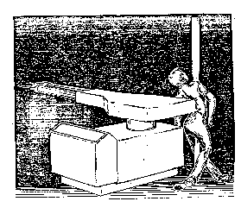
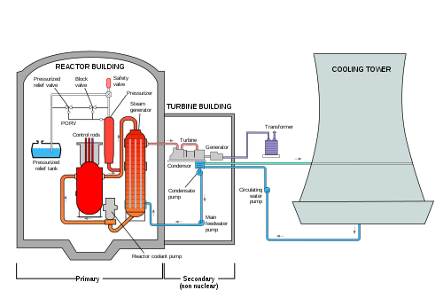

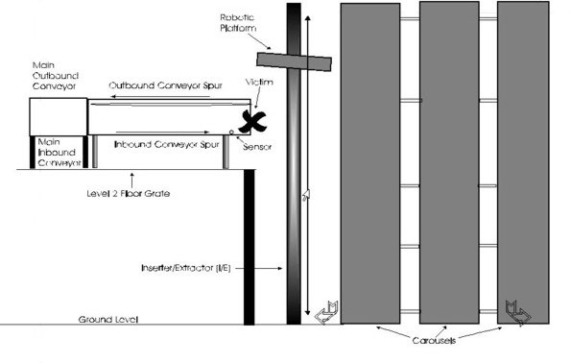
Topic 3. Safety analysis method: Case studies
Case studies:
1. BP Texas Refinery Isomerisation Unit Explosion
2. Three Mile Island (TMI) Nuclear accident
3. A fatal incident of an operator of an automated die-cast system
4. An operator was crushed by a robotic platform
Tasks:
1. Build fault tree of the top event
2. Safety analysis

Slide 24
Topic 4. Reliability Analysis Methods
FTA
FTA example*: Assume that a windowless room containing a robot system has three light bulbs and one switch. The switch can only fail to close.
*Examples are from Robot System Reliability and Safety: A Modern Approach By B.S. Dhillon

Slide 25
Topic 4. Reliability Analysis Methods: case studies
Case studies:
1. BP Texas Refinery Isomerisation Unit Explosion
2. Three Mile Island (TMI) Nuclear accident
3. A fatal incident of an operator of an automated die-cast system
4. An operator was crushed by a robotic platform
Tasks:
Calculate the top event probability given information based on the developed fault tree

Slide 26
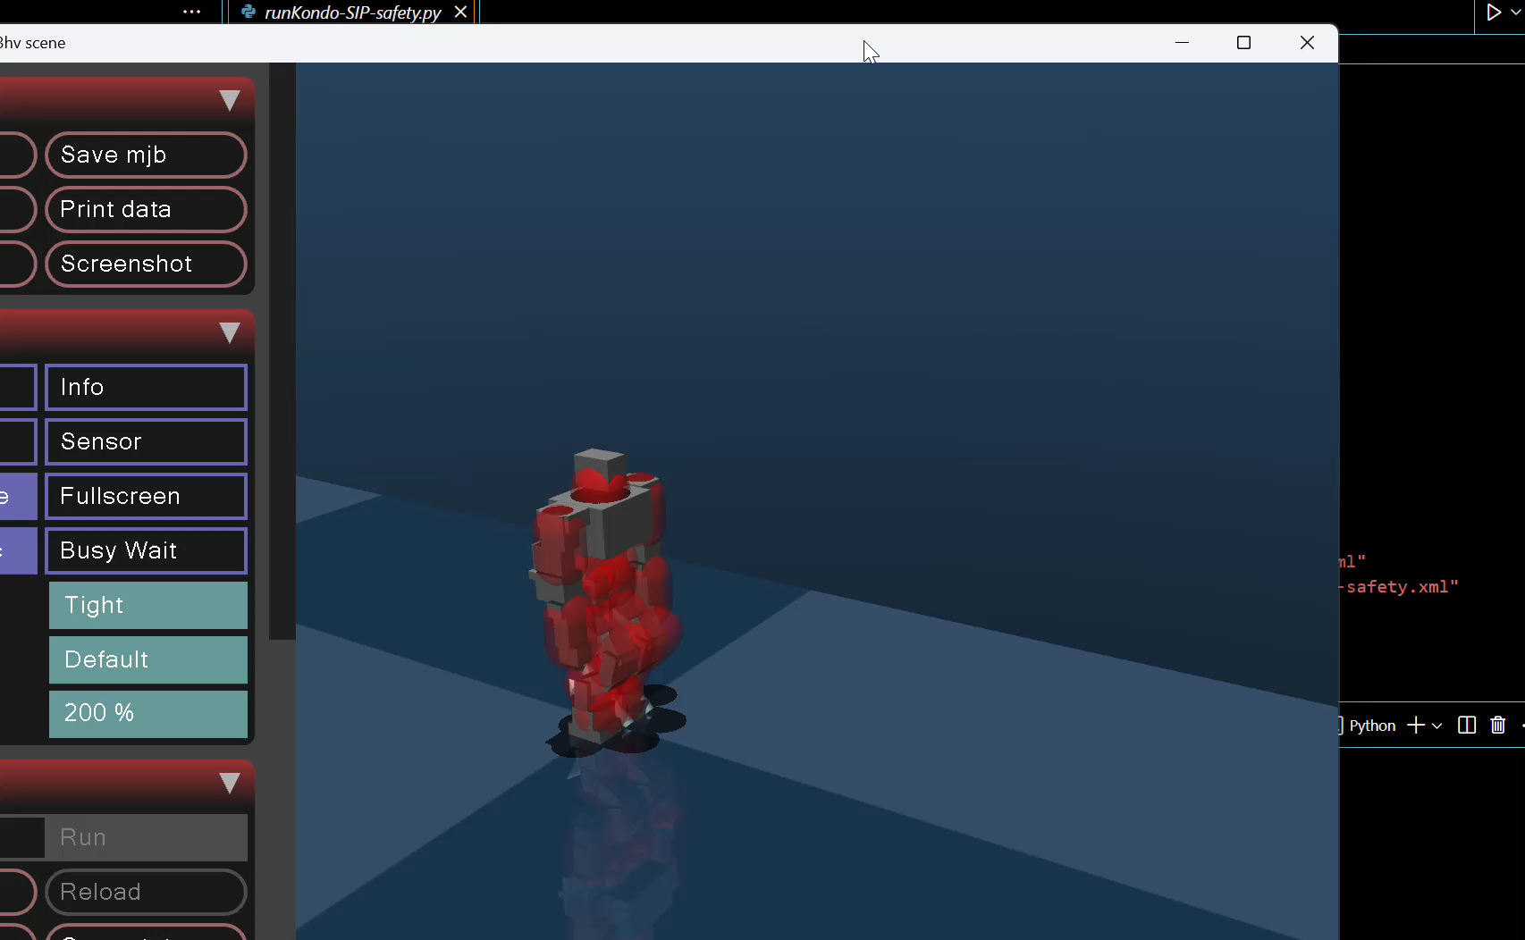
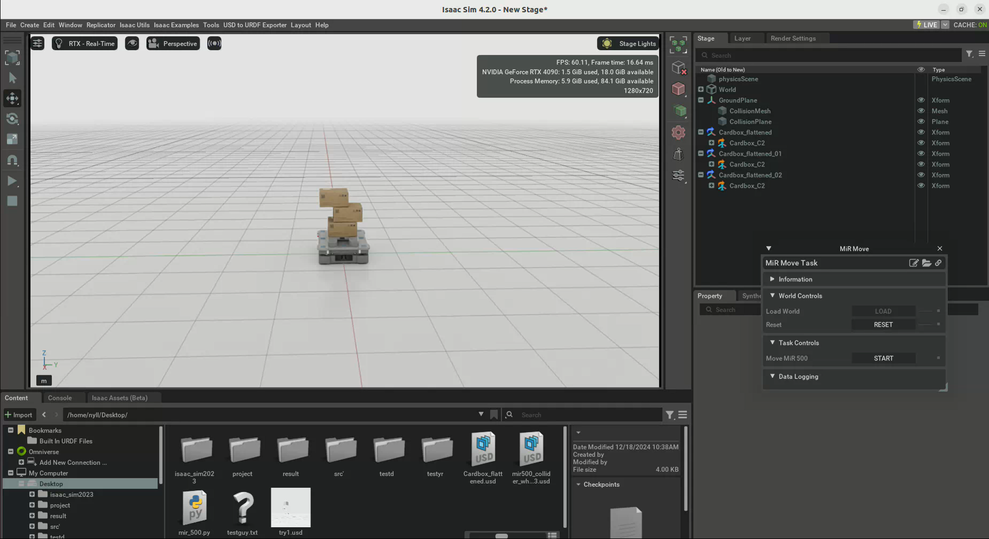
Topic 5. Risk Assessment and AI
1. Risk estimation
2. Risk evaluation
3. Risk reduction
Notes:
Checklist ISO/TR 14121-2: 2012 p6

Slide 27
Topic 5 . Risk Assessment (Digital twin)
Guest lecture: Digital twin for verification and validation
Haiyan Wu, PhD
Virtual Development Specialist
@ Novo Nordisk | PhD in Robotics | Virtual Development and Manufacturing | Digital Twin | AI | Technology Innovation for Future Pharmaceutical Manufacturing

Slide 28

Course requirement
The course is a 5-point course.
After four weeks, you cannot quit the course.
The exercises must be presented or submitted for being eligible for the final project.
The course is assessed by the final project report.

Slide 29
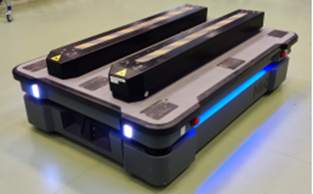
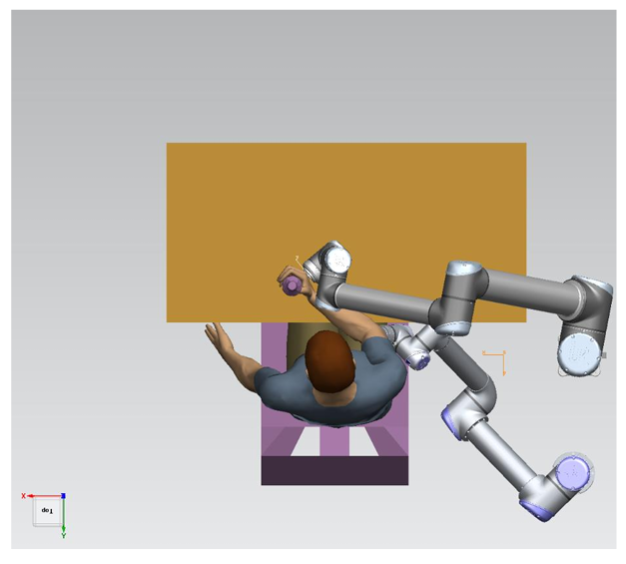
Final project
Perform risk assessment according to ISO 12100 and write sections of risk assessment report
MiR 500
(Manufacturing)
Fort RD 25
(Agriculture)
Reharob 3.0
(Healthcare)
Pick and place
(Slaughter house)

